Slide 1
COLD WAR CONFLICTS
U.S vs. U.S.S.R.

Slide 2
THE YALTA CONFERENCE
In February 1945, as the Allies pushed toward victory in Europe, an ailing FDR met with Churchill and Stalin at the Black Sea resort of Yalta in the USSR
A series of compromises were worked out concerning postwar Europe
(L to R) Churchill, FDR and Stalin at Yalta

Slide 3
YALTA AGREEMENTS
1) They agreed to divide Germany into 4 occupied zones after the war
2) Stalin agreed to free elections in Eastern Europe
3) Stalin agreed to help the U.S. in the war against Japan and to join the United Nations

Slide 4
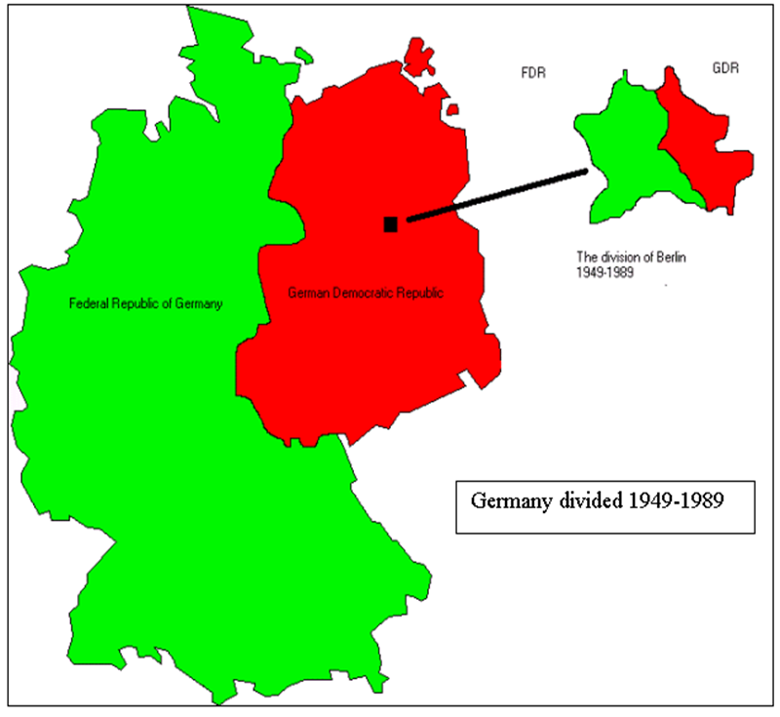

Slide 5
ORIGINS OF THE COLD WAR
After being Allies during WWII, the U.S. and U.S.S.R. soon viewed each other with increasing suspicion
Their political differences created a climate of icy tension that plunged the two countries into an era of bitter rivalry known as the Cold War
The Cold War would dominate global affairs from 1945 until the breakup of the USSR in 1991

Slide 6
Video #1
How did the rivalry between the US and Russia start?
What was the foundation for this rivalry?
What happened at the Potsdam Conference that fueled this rivalry?
How did the atomic bomb provide leverage for the US over Stalin?

Slide 7
POLITICAL DIFFERENCES
At the heart of the tension was a fundamental difference in political systems
America is a democracy that has a capitalist economic system, free elections and competing political parties
In the U.S.S.R., the sole political party – the Communists – established a totalitarian regime with little or no rights for the citizens
Soviets viewed Marx, Engels and Lenin as founders of Communism

Slide 8
SUSPICIONS DEVELOPED DURING THE WAR
ISSUES
Even during the war, the two nations disagreed on many issues
The U.S. was furious that Soviet leader Joseph Stalin had been an ally of Hitler for a time
Stalin was upset that the U.S. had kept its development of the atomic bomb a secret

Slide 9
THE UNITED NATIONS PROVIDES HOPE
Hopes for world peace were high at the end of the war
The most visible symbol of these hopes was the United Nations (U.N.)
Formed in June of 1945, the U.N. was composed of 50 nations
Unfortunately, the U.N. soon became a forum for competing superpowers to spread their influence over others
The United Nations today has 191 member countries

Slide 10
SOVIETS DOMINATE EASTERN EUROPE
The Soviet Union suffered an estimated 20 million WWII deaths, half of whom were civilian
As a result they felt justified in their claim to Eastern Europe
Furthermore, they felt they needed Eastern Europe as a buffer against future German aggression

Slide 11
STALIN INSTALLS PUPPET GOVERNMENTS
Stalin installed “satellite” communist governments in the Eastern European countries of Albania, Bulgaria, Czechoslovakia, Hungary, Romania, Yugoslavia and East Germany
This after promising “free elections” for Eastern Europe at the Yalta Conference
In a 1946 speech, Stalin said communism and capitalism were incompatible – and another war was inevitable

Slide 12
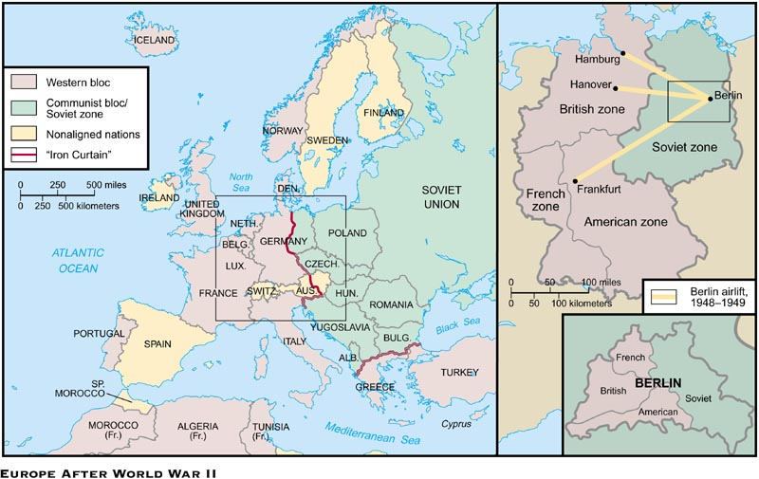

Slide 13
U.S. ESTABLISHES A POLICY OF CONTAINMENT
Faced with the Soviet threat, Truman decided it was time to “stop babying the Soviets”
In February 1946, George Kennan, an American diplomat in Moscow, proposed a policy of containment
Containment meant the U.S. would prevent any further extension of communist rule

Slide 14
CHURCHILL: “IRON CURTAIN” ACROSS EUROPE
Europe was now divided into two political regions; a mostly democratic Western Europe and a communist Eastern Europe
In a 1946 speech, Churchill said, “An iron curtain has descended across the continent”
The phrase “iron curtain” came to stand for the division of Europe
Churchill, right, in Fulton, Missouri delivering his “iron curtain” speech, 1946

Slide 15
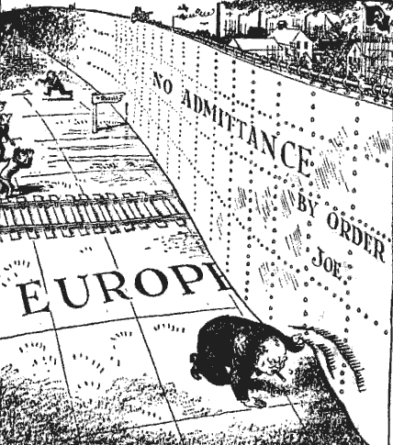
Iron Curtain cartoon, 1946

Slide 16
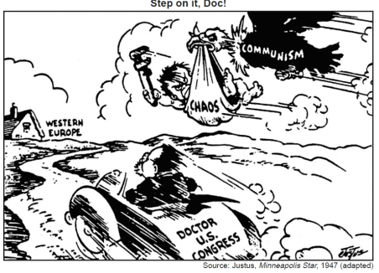

Slide 17
THE TRUMAN DOCTRINE
The American policy of “ containment” soon expanded into a policy known as the Truman Doctrine”
This doctrine, first used in Greece and Turkey in the late 1940s, vowed to provide aid (money & military supplies) to support “free peoples who are resisting outside pressures”
By 1950, the U.S. had given $400 million in aid to Greece and Turkey

Slide 18
Video #2
Why did Stalin want a buffer zone?
What was the Long Telegram? What did this telegram emphasize?
Why, according to Marshall would Europeans turn to Communism?

Slide 19
THE MARSHALL PLAN
Post-war Europe was devastated economically
In June 1947, Secretary of State George Marshall proposed a U.S. aid package to European nations
Western Europe accepted the help, while Eastern Europe rejected the aid
Over the next four years 16 European countries received $13 billion in U.S. aid
By 1952 Western Europe’s economy was flourishing
The Marshall Plan helped Western Europe recover economically

Slide 20
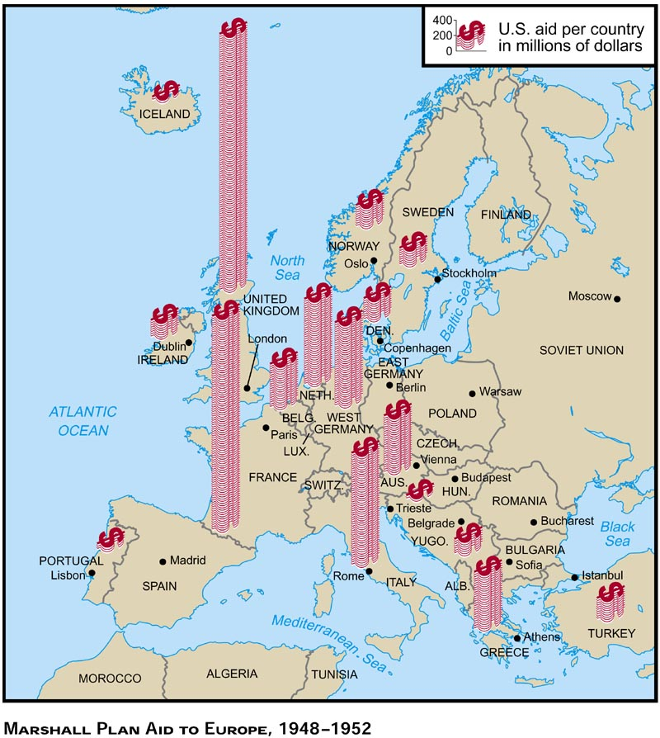
Marshall Plan aid sent to European countries

Slide 21
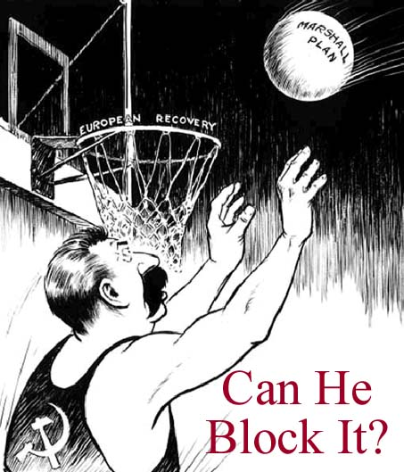
Marshall Aid cartoon, 1947

Slide 22
SUPERPOWERS STRUGGLE OVER GERMANY
At the end of the war, Germany was divided among the Allies into four zones for the purpose of occupation
The U.S, France, and Great Britain decided to combine their 3 zones into one zone – West Germany, or the federal Republic of Germany
The U.S.S.R. controlled East Germany, or the German Democratic Republic
Now the superpowers were occupying an area right next to each other – problems were bound to occur

Slide 23
BERLIN AIRLIFT – 1948
When the Soviets attempted to block the three Western powers from access to Berlin in 1948, the 2.1 million residents of West Berlin had only enough food for five weeks, resulting in a dire situation
Like the whole of Germany, the city of Berlin was divided into four zones

Slide 24
AMERICA & BRITAIN AIRLIFT SUPPLIES TO WEST BERLIN
Not wanting to invade and start a war with the Soviets, America and Britain started the Berlin airlift to fly supplies into West Berlin
For 327 days, planes took off and landed every few minutes, around the clock
In 277,000 flights, they brought in 2.3 million tons of food, fuel and medicine to the West Berliners

Slide 25
SOVIETS LIFT BLOCKADE
Realizing they were beaten and suffering a public relations nightmare, the Soviets lifted their blockade in May, 1949
On Christmas 1948, the plane crews brought gifts to West Berlin

Slide 26
NATO FORMED
The Berlin blockade increased Western Europe’s fear of Soviet aggression
As a result, ten West European nations joined the U.S and Canada on April 4, 1949 to form a defensive alliance known as the North Atlantic Treaty Organization
The NATO flag

Slide 27
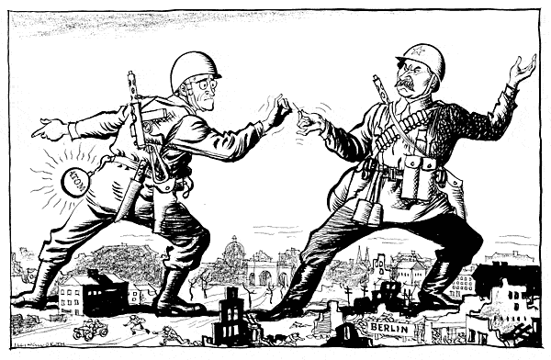

Slide 28
